Slide 1

CSE 471 Machine Learning
Logistic Regression
Prepared by
Madhusudan Basak
Assistant Professor
CSE, BUET

Slide 2
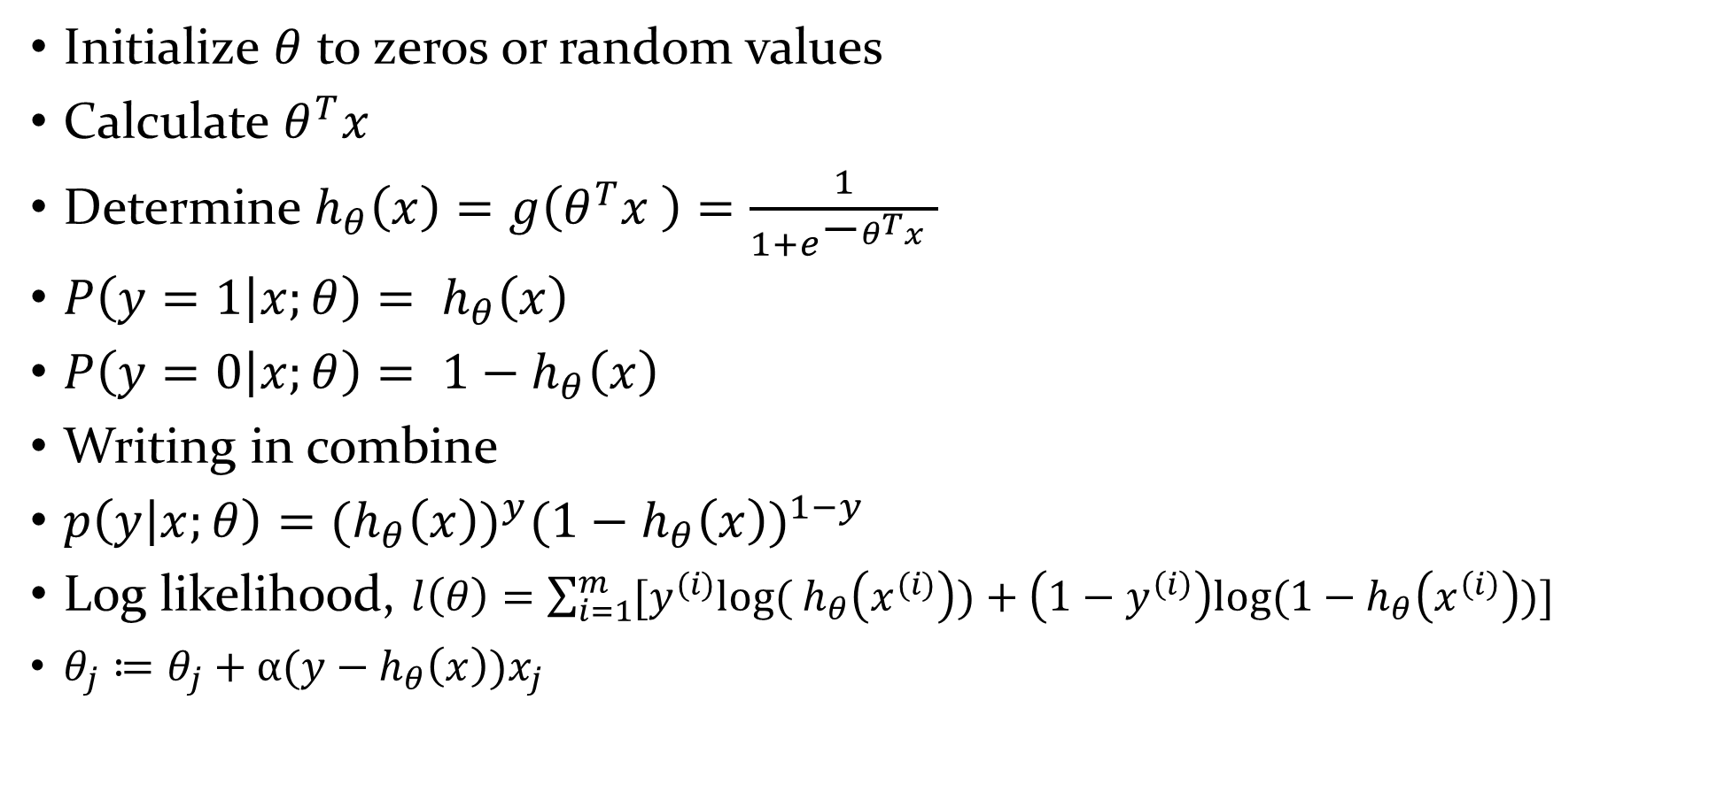
Logistic Regression
Initialize $θ$ to zeros or random values
Calculate $θ^{T}x$
Determine $h_{θ}\left(x\right)=g\left(θ^{T}x \right)=\frac{1}{1+e^{\text{−}θ^{T}x }}$
$P\left(y=1 | x;θ\right)= h_{θ}\left(x\right)$
$P\left(y=0 | x;θ\right)= {1−h}_{θ}\left(x\right)$
Writing in combine
$p\left(y | x;θ\right)={(h_{θ}\left(x\right))}^{y}{({1−h}_{θ}\left(x\right))}^{1−y}$
Log likelihood, $l\left(θ\right)=\sum_{i=1}^{m}{{[y}^{(i)}log⁡(}$ $h_{θ}\left(x^{(i)}\right))+\left(1−y^{\left(i\right)}\right)log⁡({1−h}_{θ}\left(x^{\left(i\right)}\right))]$
$θ_{j}≔θ_{j}+α(y−h_{θ}\left(x\right))x_{j}$

Slide 3
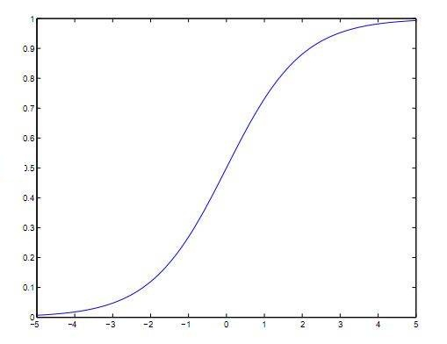



Classifier and likelihood
$p\left(y | x;θ\right)={(h_{θ}\left(x\right))}^{y}{({1−h}_{θ}\left(x\right))}^{1−y}$
$log⁡_likelihood=\log{0.7}+\log{0.75}+\log{0.95}+\log{0.9}+\log{0.75}+\log{0.8}+\log{0.9+\log{0.95=−0.63}}$
G
$$x_{2}$$
F
D
H
B
C
E
A
A
D
y
L1
B
$$x_{1}$$
Class
F
E
C
H
G
θ ^{T}x

Slide 4



Classifier and likelihood
$p\left(y | x;θ\right)={(h_{θ}\left(x\right))}^{y}{({1−h}_{θ}\left(x\right))}^{1−y}$
$log⁡_likelihood=\log{0.8}+\log{0.9}+\log{0.95+\log{0.85}}+\log{0.65}+\log{0.8}+\log{0.9+\log{0.7=−0.72}}$
G
$$x_{2}$$
F
B
H
D
C
E
A
L2
A
D
y
E
B
H
$$x_{1}$$
Class
F
C
G
So, the previous one was better
θ ^{T}x

Slide 5



Multiclass Classification
One-vs-all or one-vs-rest
Consider green points as a single class and all other points into as another class
Find out the best classifier $h_{θ}^{(1)}$
G
$$x_{2}$$
F
E
D
H
Classifier 1
A
B
$$x_{1}$$
C

Slide 6

Multiclass Classification
One-vs-all or one-vs-rest
Consider red points as a single class and all other points into as another class
Find out the best classifier $h_{θ}^{(2)}$
G
$$x_{2}$$
F
E
D
H
Classifier 2
A
B
$$x_{1}$$
C

Slide 7

Multiclass Classification
One-vs-all or one-vs-rest
Finally, Consider violet points as a single class and all other points into as another class
Find out the best classifier $h_{θ}^{(3)}$
G
$$x_{2}$$
F
E
D
H
A
B
$$x_{1}$$
C
Classifier 3

Slide 8
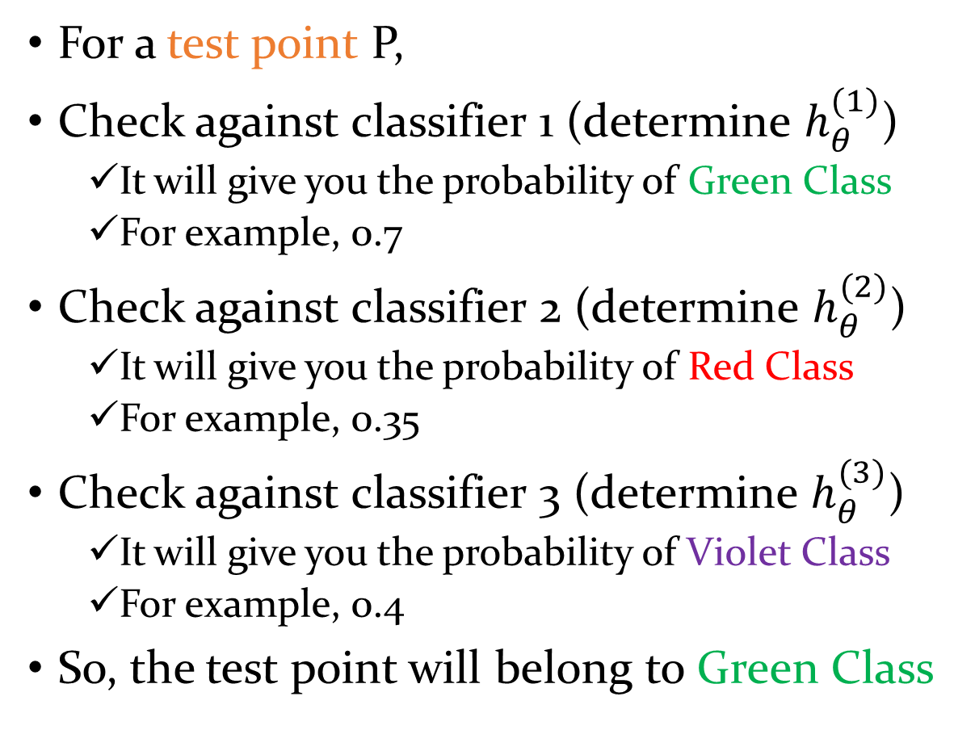
Multiclass Classification
For a test point P,
Check against classifier 1 (determine $h_{θ}^{(1)}$)
It will give you the probability of Green Class
For example, 0.7
Check against classifier 2 (determine $h_{θ}^{(2)}$)
It will give you the probability of Red Class
For example, 0.35
Check against classifier 3 (determine $h_{θ}^{(3)}$)
It will give you the probability of Violet Class
For example, 0.4
So, the test point will belong to Green Class
G
$$x_{2}$$
F
E
D
H
Classifier 1
A
P
Classifier 2
B
$$x_{1}$$
C
Classifier 3

Slide 9

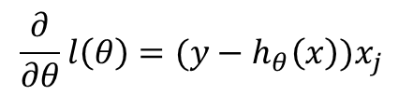



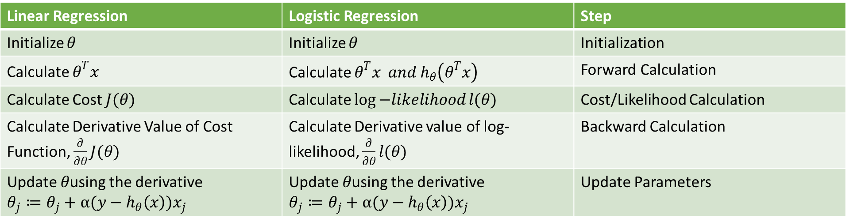







Steps in summary
Linear Regression | Logistic Regression | Step
Initialize $θ$ | Initialize $θ$ | Initialization
Calculate $θ^{T}x$ | Calculate $θ^{T}x and h_{θ}\left(θ^{T}x\right)$ | Forward Calculation
Calculate Cost $J(θ)$ | Calculate $\log{−likelihood}l(θ)$ | Cost/Likelihood Calculation
Calculate Derivative Value of Cost Function, $\frac{∂}{∂θ}J(θ)$ | Calculate Derivative value of log-likelihood, $\frac{∂}{∂θ}l(θ)$ | Backward Calculation
Update $θ$using the derivative $$θ_{j}≔θ_{j}+α(y−h_{θ}\left(x\right))x_{j}$$ | Update $θ$using the derivative $$θ_{j}≔θ_{j}+α(y−h_{θ}\left(x\right))x_{j}$$ | Update Parameters
$$x_{0}$$
$$θ_{0}$$
$$θ^{T}x$$
$$θ_{1}$$
.
$$x_{1}$$
$$h_{θ}\left(θ^{T}x\right)=\hat{y}(x)$$
$$y(x)$$
$$x_{2}$$
$$θ_{2}$$
$l(θ)$
$$θ_{j}≔θ_{j}+α(y−h_{θ}\left(x\right))x_{j}$$
$$\frac{∂}{∂θ}l\left(θ\right)=(y−h_{θ}\left(x\right))x_{j}$$

Slide 10

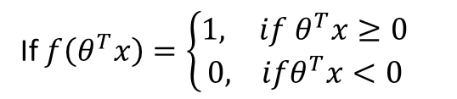

Steps in summary
Linear Regression | Logistic Regression | Step
Initialize $θ$ | Initialize $θ$ | Initialization
Calculate $θ^{T}x$ | Calculate $θ^{T}x and h_{θ}\left(θ^{T}x\right)$ | Forward Calculation
Calculate Cost $J(θ)$ | Calculate $\log{−likelihood}l(θ)$ | Cost/Likelihood Calculation
Calculate Derivative Value of Cost Function, $\frac{∂}{∂θ}J(θ)$ | Calculate Derivative value of log-likelihood, $\frac{∂}{∂θ}l(θ)$ | Backward Calculation
Update $θ$using the derivative $$θ_{j}≔θ_{j}+α(y−h_{θ}\left(x\right))x_{j}$$ | Update $θ$using the derivative $$θ_{j}≔θ_{j}+α(y−h_{θ}\left(x\right))x_{j}$$ | Update Parameters
If $f\left(θ^{T}x\right)=\left\{\begin{aligned}1,{ if θ}^{T}x≥0 \\ &0, ifθ^{T}x<0\end{aligned}\right.$
$$x_{0}$$
$$θ_{0}$$
$$θ^{T}x$$
$$θ_{1}$$
.
$$x_{1}$$
$$f\left(θ^{T}x\right)=\hat{y}(x)$$
$$y(x)$$
$$x_{2}$$
$$θ_{2}$$
Cost = $y\left(x\right)−\hat{y}\left(x\right)$

Slide 11
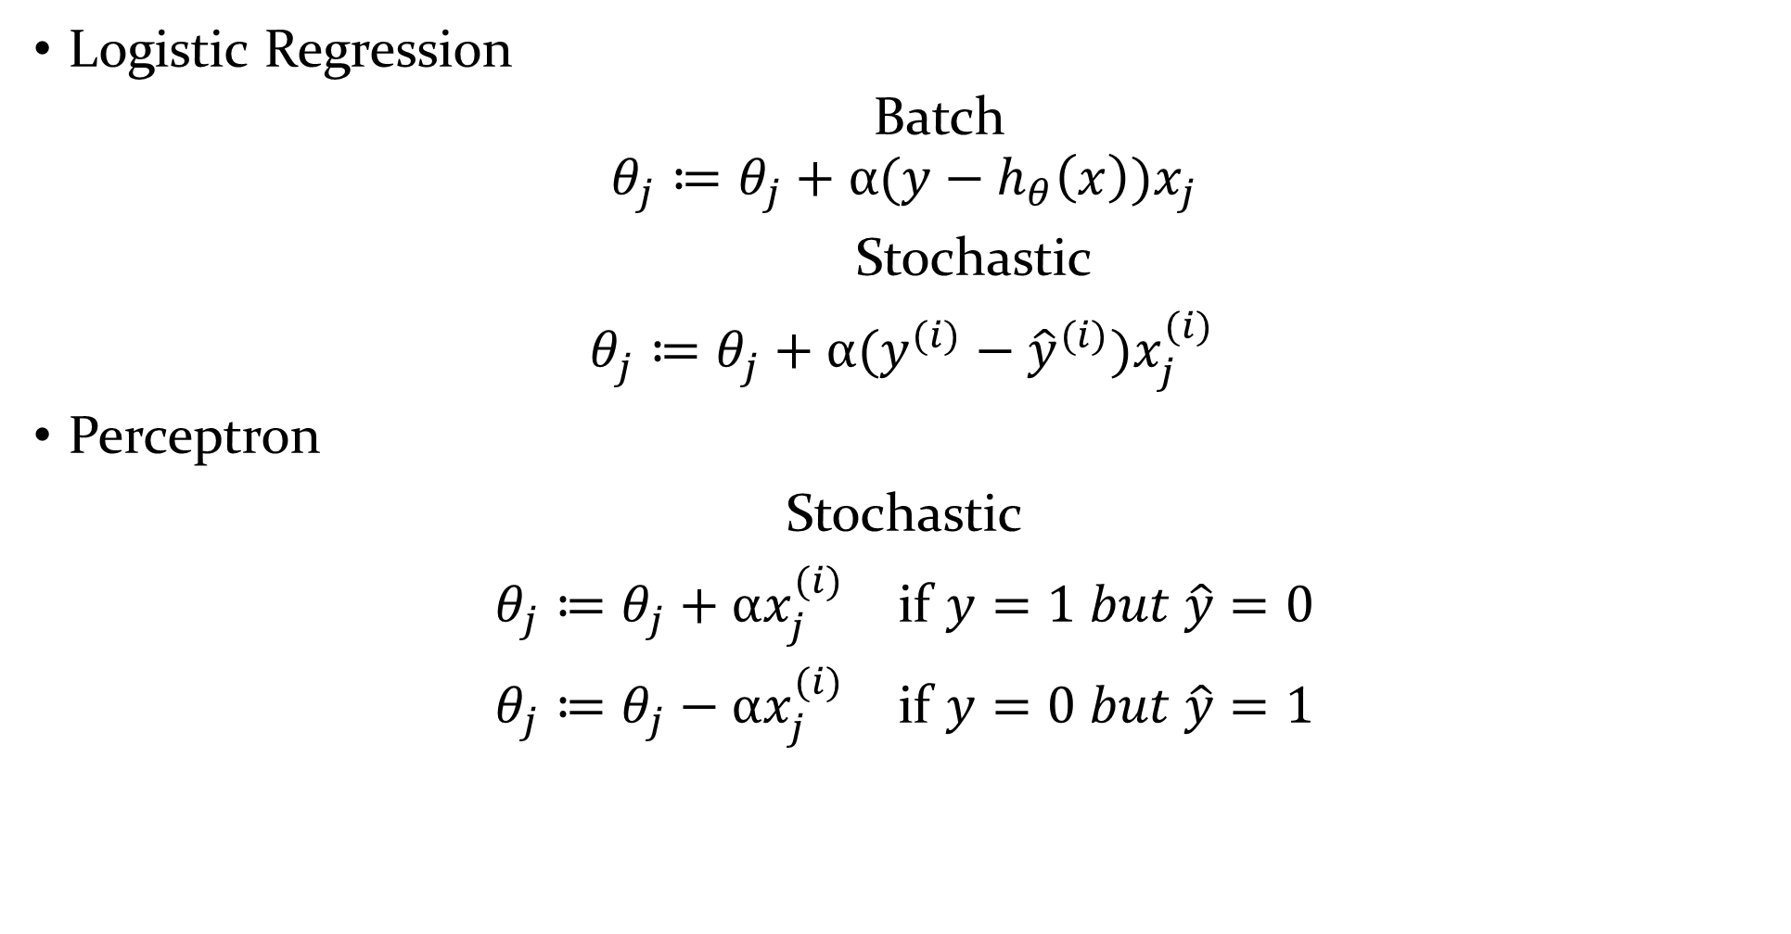
Perceptron
Logistic Regression
Batch
$$θ_{j}≔θ_{j}+α(y−h_{θ}\left(x\right))x_{j}$$
Stochastic
$θ_{j}^{}≔θ_{j}^{}+α(y^{(i)}−{\hat{y}}^{(i)})x_{j}^{(i)}$
Perceptron
Stochastic
$θ_{j}≔θ_{j}+αx_{j}^{(i)}$ if $y=1 but \hat{y}=0$
$θ_{j}≔θ_{j}−αx_{j}^{(i)}$ if $y=0 but \hat{y}=1$

Slide 12
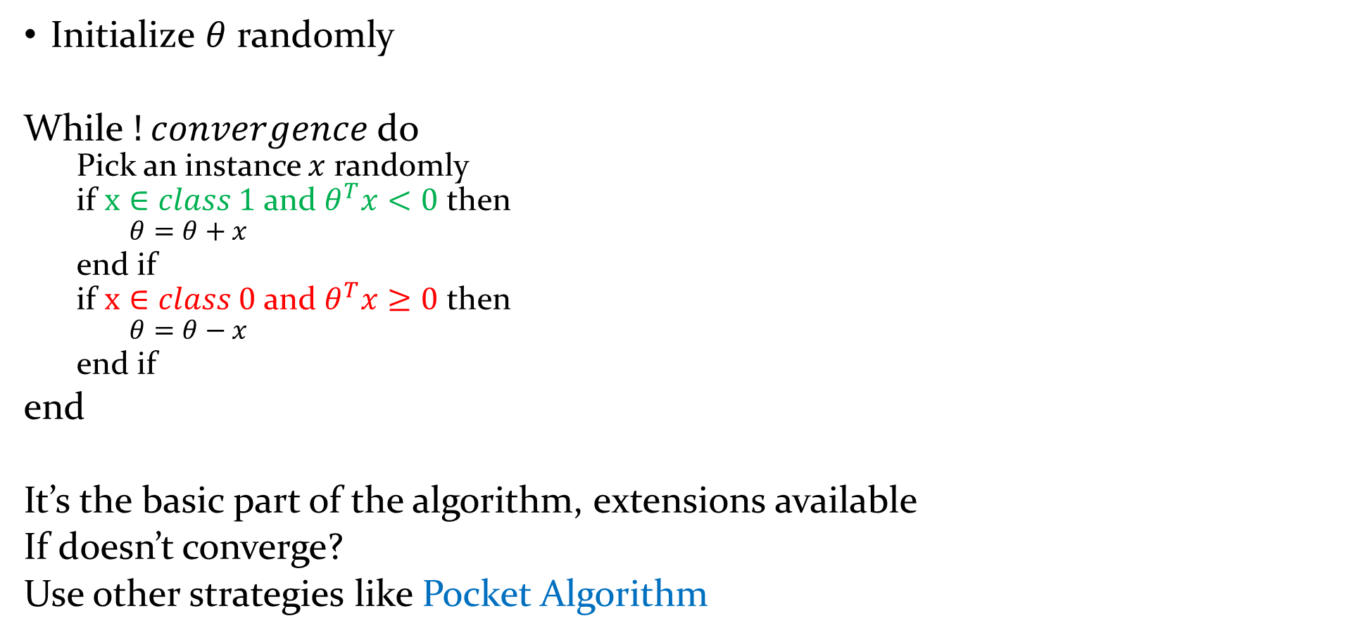
Perceptron
Initialize $θ$ randomly
While $!convergence$do
Pick an instance $x$ randomly
if $x∈class 1$and $θ^{T}x<0$ then
$$θ=θ+x$$
end if
if $x∈class 0$and $θ^{T}x≥0$ then
$$θ=θ−x$$
end if
end
It’s the basic part of the algorithm, extensions available
If doesn’t converge?
Use other strategies like Pocket Algorithm

Slide 13

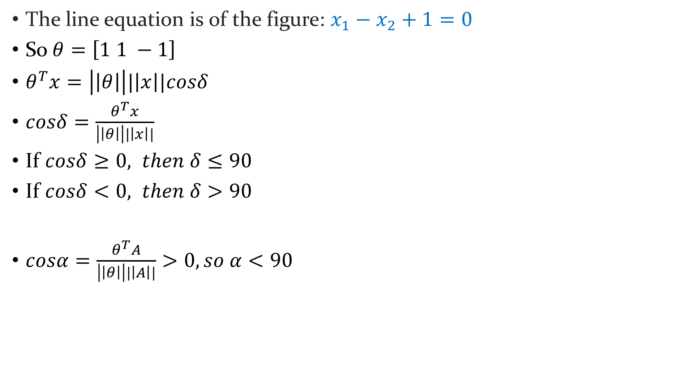



Perceptron
The line equation is of the figure: $x_{1}−x_{2}+1=0$
So $θ=\left[1 1 −1\right]$
$θ^{T}x=\left|\left|θ\right|\right||\left|x\right||cosδ$
$cosδ=\frac{θ^{T}x}{\left|\left|θ\right|\right||\left|x\right||}$
If $cosδ≥0, then δ≤90$
If $cosδ<0, then δ>90$
$cosα=\frac{θ^{T}A}{\left|\left|θ\right|\right||\left|A\right||}>0, so α<90$
G
$$x_{2}$$
F
H
I
E
A
D
$$α$$
L1
B
J
$$x_{1}$$
C
$$θ$$

Slide 14








Logistic Unit
$$x_{0}$$
$$θ_{0}$$
$$θ^{T}x$$
$$θ_{1}$$
.
$$x_{1}$$
$$h_{θ}\left(θ^{T}x\right)=\hat{y}(x)$$
$$x_{2}$$
$$θ_{2}$$

Slide 15

Logistic Unit
$$x_{0}$$
$$θ_{0}$$
$$θ_{1}$$
$$h_{θ}\left(θ^{T}x\right)=\hat{y}(x)$$
$$x_{1}$$
$$x_{2}$$
$$θ_{2}$$

Slide 16



Logistic Unit
G
$$x_{0}$$
$$θ_{0}$$
$$x_{2}$$
F
$$θ_{1}$$
$$\hat{y}(x)$$
$$x_{1}$$
H
$$θ_{2}$$
E
$$x_{2}$$
A
D
L1
B
$$x_{1}$$
C

Slide 17
Logistic Unit
$$x_{0}$$
$$θ_{0}$$
H
E
$$x_{2}$$
$$θ_{1}$$
$$\hat{y}(x)$$
$$x_{1}$$
$$x_{2}$$
$$θ_{2}$$
D
G
A
C
L1
B
$$x_{1}$$
F

Slide 18







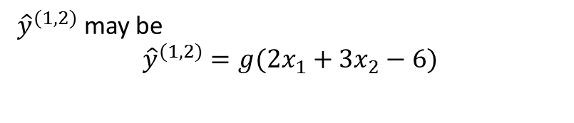

Logistic Unit
L2
$$x_{0}$$
$$θ_{1,0}$$
H
E
$$θ_{2,0}$$
$${\hat{y}}^{(1,1)}(x)$$
$$x_{2}$$
$$θ_{1,1}$$
$$x_{1}$$
$$θ_{2,1}$$
$$θ_{1,2}$$
$${\hat{y}}^{(1,2)}(x)$$
$$x_{2}$$
A
D
$$θ_{2,2}$$
G
C
${\hat{y}}^{(1,2)}$ may be
$${\hat{y}}^{(1,2)}=g(2x_{1}+3x_{2}−6)$$
L1
B
$$x_{1}$$
F
Class y
θ ^{T}x

Slide 19

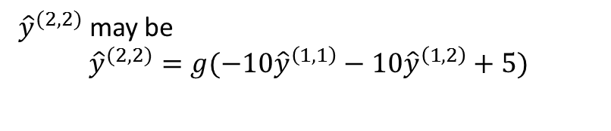
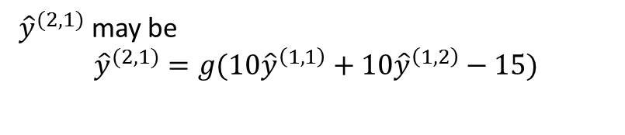





Logistic Unit
1
$${\hat{y}}^{(2,1)}$$
L2
$$x_{0}$$
$$θ_{1,0}$$
H
E
$$θ_{2,0}$$
$$x_{2}$$
$$θ_{1,1}$$
$${\hat{y}}^{(1,1)}$$
$${\hat{y}}^{(2,2)}$$
$$x_{1}$$
$$θ_{2,1}$$
$$θ_{1,2}$$
$$x_{2}$$
A
D
$$θ_{2,2}$$
$${\hat{y}}^{(1,2)}$$
G
C
L1
B
${\hat{y}}^{(2,1)}$ may be
$${\hat{y}}^{(2,1)}=g(10{\hat{y}}^{\left(1,1\right)}+10{\hat{y}}^{\left(1,2\right)}−15)$$
$$x_{1}$$
F
$${\hat{y}}^{\left(1,2\right)}$$
${\hat{y}}^{(2,2)}$ may be
$${\hat{y}}^{(2,2)}=g(−10{\hat{y}}^{\left(1,1\right)}−10{\hat{y}}^{\left(1,2\right)}+5)$$
$${\hat{y}}^{\left(1,1\right)}$$

Slide 20

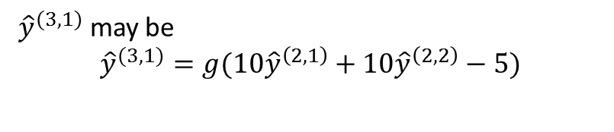




Logistic Unit
1
1
$${\hat{y}}^{(2,1)}$$
$$x_{0}$$
$$θ_{1,0}$$
$${\hat{y}}^{(3,1)}$$
$$θ_{2,0}$$
$${\hat{y}}^{\left(1,2\right)}$$
$$θ_{1,1}$$
$${\hat{y}}^{(1,1)}$$
$${\hat{y}}^{(2,2)}$$
$$x_{1}$$
$$θ_{2,1}$$
$$θ_{1,2}$$
$$x_{2}$$
$${\hat{y}}^{\left(1,1\right)}$$
$$θ_{2,2}$$
$${\hat{y}}^{(1,2)}$$
${\hat{y}}^{(3,1)}$ may be
$${\hat{y}}^{(3,1)}=g(10{\hat{y}}^{\left(2,1\right)}+10{\hat{y}}^{\left(2,2\right)}−5)$$
$${\hat{y}}^{\left(2,2\right)}$$
$${\hat{y}}^{\left(2,1\right)}$$

Slide 21

Logistic Unit
1
$${\hat{y}}^{(2,1)}$$
L2
$$x_{0}$$
$$θ_{1,0}$$
H
E
$$θ_{2,0}$$
$$x_{2}$$
$$θ_{1,1}$$
$${\hat{y}}^{(1,1)}$$
$${\hat{y}}^{(2,2)}$$
$$x_{1}$$
$$θ_{2,1}$$
$$θ_{1,2}$$
$$x_{2}$$
A
D
$$θ_{2,2}$$
$${\hat{y}}^{(1,2)}$$
G
C
L1
B
${\hat{y}}^{(2,1)}$ may be
$${\hat{y}}^{(2,1)}=g(10{\hat{y}}^{\left(1,1\right)}+10{\hat{y}}^{\left(1,2\right)}−15)$$
$$x_{1}$$
F
$${\hat{y}}^{\left(1,2\right)}$$
${\hat{y}}^{(2,2)}$ may be
$${\hat{y}}^{(2,2)}=g(−10{\hat{y}}^{\left(1,1\right)}−10{\hat{y}}^{\left(1,2\right)}+5)$$
$${\hat{y}}^{\left(1,1\right)}$$
$$f\left(a,b\right)=a⨁b=ab+\overline{ab}$$

Slide 22
Logistic Unit
1
1
$${\hat{y}}^{(2,1)}$$
$$x_{0}$$
$$θ_{1,0}$$
$${\hat{y}}^{(3,1)}$$
$$θ_{2,0}$$
$${\hat{y}}^{\left(1,2\right)}$$
$$θ_{1,1}$$
$${\hat{y}}^{(1,1)}$$
$${\hat{y}}^{(2,2)}$$
$$x_{1}$$
$$θ_{2,1}$$
$$θ_{1,2}$$
$$x_{2}$$
$${\hat{y}}^{\left(1,1\right)}$$
$$θ_{2,2}$$
$${\hat{y}}^{(1,2)}$$
${\hat{y}}^{(3,1)}$ may be
$${\hat{y}}^{(3,1)}=g(10{\hat{y}}^{\left(2,1\right)}+10{\hat{y}}^{\left(2,2\right)}−5)$$
$${\hat{y}}^{\left(2,2\right)}$$
$${\hat{y}}^{\left(2,1\right)}$$
$$f\left(a,b\right)=a⨁b=ab+\overline{ab}$$

Slide 23
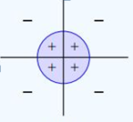
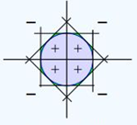
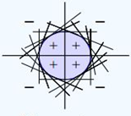
Approximating Non-linear Function

Slide 24
References
CS229 Lecture Notes by Andrew Ng

